Slide 1

Team Project: Presentation
Aly6015: intermediate Analytics
Project Name: NYPD Shooting Incident Dataset
Team members in group 5
Rupali Metkari
Chandrashekarappa Shivaprasad
Date: 21/5/2021
Professor: Vladimir Shapiro

Slide 2
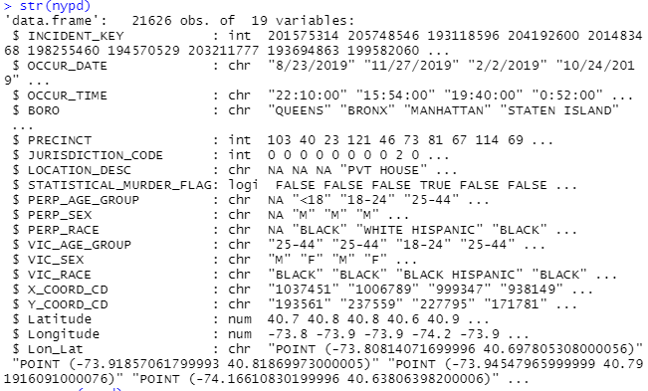
Introduction
Structure of the dataset
In this dataset listing of every shooting incident that occurred in NYC going back to 2006 to 2019 year.
Each record represents a shooting incident in NYC and includes information about the event, the location and time of occurrence. In addition, information related to suspect and victim demographics is also included.
We mainly used variables Time, Date, Boro, Murder Flag, Victim gender, Victim race.

Slide 3
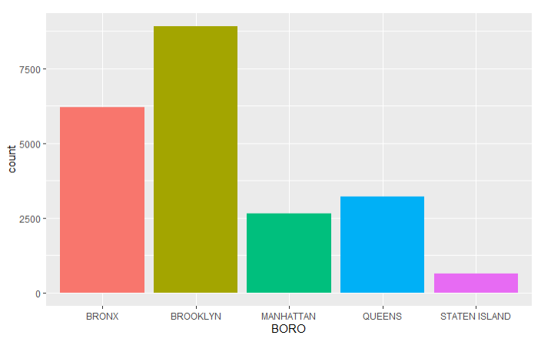
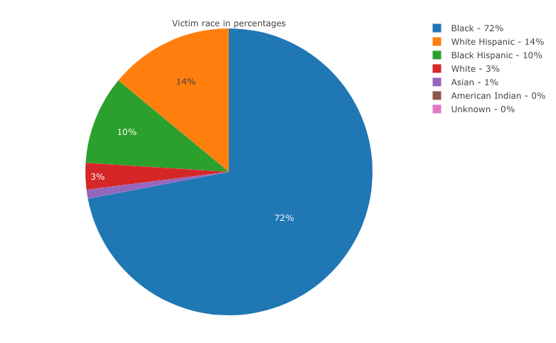
Exploratory Data Analysis-1
Crime frequency in each Boro’s
Pie chart of victim race

Slide 4
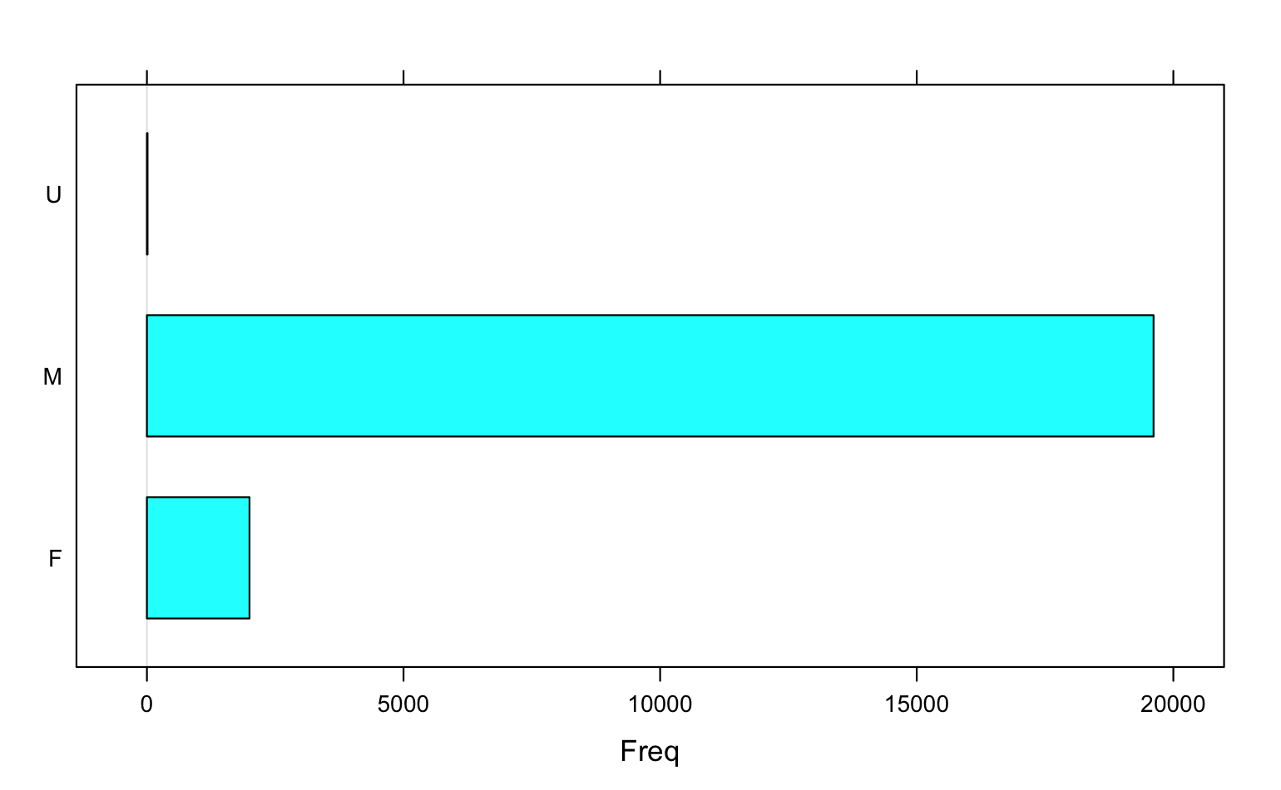
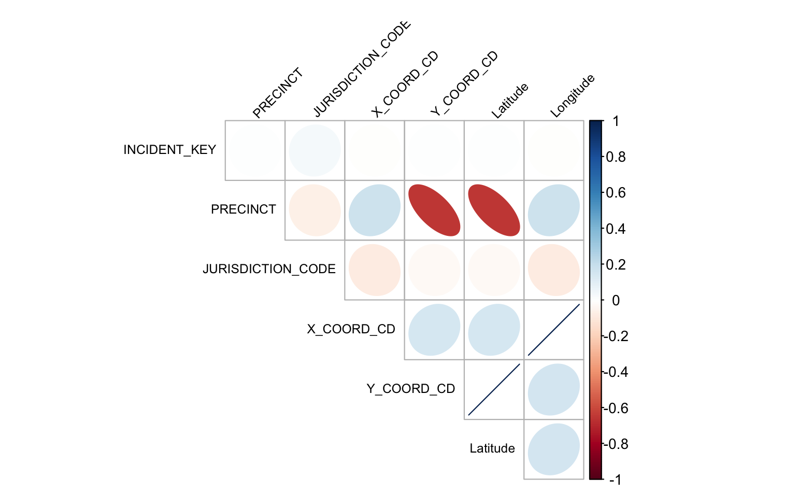
Exploratory Data Analysis- 2
Frequency of Male and Female Victim sex
Correlation between the numerical variables

Slide 5
Business Question 1
Q1: In a shootout for a person in a given year and race what are the chances of person getting shot
Justification: Statistical_Murder_Flag column is binomial and we see many cases where the murder has been registered but actually murder not happened by using a confusion matrix.
Steps Done:
From the OCCUR_DATE column: Year data is extracted
VIC_Race column- Each race is renamed in to number 1 to 7
Statistical_Murder_Flag column: Subset of TRUE and FALSE is created
Data is split to 70:30 ratio
Support Vector Machine model is run on the train data and predicted with test data

Slide 6
Output of Q1
The accuracy of the model is 45% with 95% C.I
3526 times the in the data set murders were classified correctly as TRUE and 691 time were correctly predicted as false. 4557 times classified as true but termed as false and 602 times where the murder did not occur but classified as murder.

Slide 7
Business Question 2
Q2: As safety and protection of the black race, we would like to find out that can we predict if New York City is safer for the black race over the years
Method to use: Naive Bayes model
Justification: We use the Occur date, victim race in the prediction model. This is an important societal question to solve and predict if New York City is safe for the black race. The target variable is victim race
From Occur date – year data is extracted
All the races apart from Black race has been grouped as Other
Dataset is created with year and race
The new dataset is split in to train and test data set with 70:30 ratio
Naive Bayes program is used to create a model

Slide 8
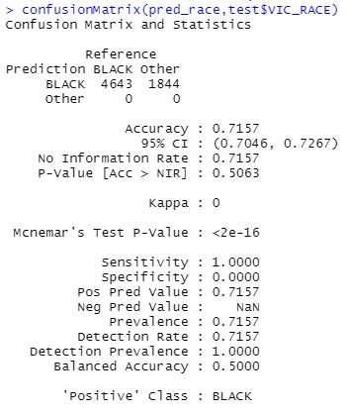
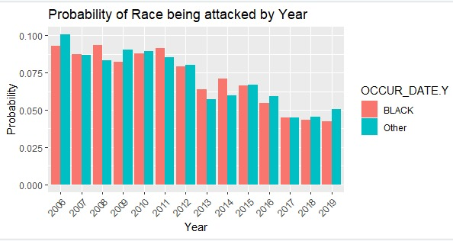
Output of Q2
We can see that in the years 2008, 2011, 2014 were higher victims compared to all other races combined.
Over the years, the probability of black race victims has reduced compared to other races
The accuracy of the model is 71% with 95% C.I
We can predict that black race victims is reducing over the years in New York

Slide 9
Business Question 3
Q3: Can we predict, if New York City is safer for women at the night compared to the day?
Justification: We use the victim sex, time variables and location in the prediction model. This will help in predicting the specific prediction between the associated variables. It also includes categorical variables in its system. The target variable is victim sex
From occur time – Morning, Evening and Night has been divided into 3 categories
Victim Sex- U- unknown M men is removed form the dataset
Dataset is created with Victim sex and Time is created
The new dataset is split in to train and test data set with 70:30 ratio
Naive Bayes model program is used to create a model

Slide 10
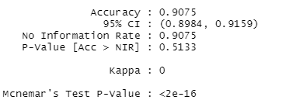
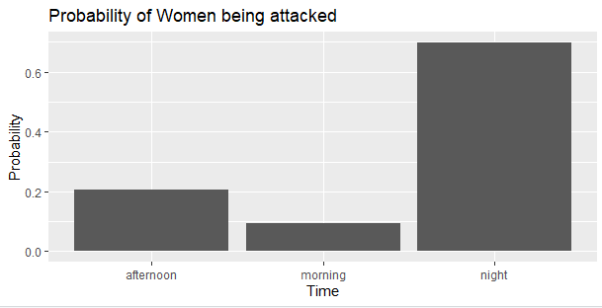
Output of Q3
The accuracy of the model is 90% with 95% C.I
We can predict that probability of female sex victims were attacked more in the night from 6 pm to 6 am compared to morning and evening

Slide 11
Conclusion
Importance of Exploratory data analysis helped in framing the business questions
There is 60% probability that person will not be shot at with the help of SVM model
Shooting against black race is reducing over the years
Shooting against women in the night time is high compared to the morning
RECOMMENDATIONS:
Educate the police officers on not making generalized decisions based on race
Create a support group and educating women on their personal safety
Increase the number of women police officers in the night
Data collection on gender based crimes has to be increased that can help establishing policies and implement crime prevention against women

Slide 12
REFERENCES
NYPD Shooting Incident Data (Historic) Last Updated 3 May 2021, Open Data Network: https://opendatanetwork.herokuapp.com/dataset/data.cityofnewyork.us/833y-fsy8
Analyzing crime in NYC: data, visuals, Posted by NYC Data Science Academy on August 18, 2016, Data Science Central: https://www.datasciencecentral.com/profiles/blogs/7-sins-in-nyc
NEW YORK CITY CRIME STUDY FROM(9/8/2020), CAP INDEX: https://capindex.com/covid-19-crime-new-york-city-crime-study-for-2020/
Support Vector Machine In R, by Zulaika Lateef, Last updated on May 15,2020, Edureka: https://www.edureka.co/blog/support-vector-machine-in-r/
Complete Introduction to Linear Regression in R by Selva Prabhakaran(2019) ML+ Let's DataScience: https://www.machinelearningplus.com/machine-learning/complete-introduction-linear-regression-r/
Naïve Bayes Classifier, UC Business Analytics R Programming Guide: https://uc-r.github.io/naive_bayes
Take action: 10 ways you can help end violence against women, even during a pandemic. (n.d.). Retrieved May 21, 2021, from https://www.unwomen.org/en/news/stories/2020/11/compilation-take-action-to-help-end-violence-against-women

